Slide 1
The Foundations: Logic and Proofs
Chapter 1, Part III: Proofs
With Question/Answer Animations

Slide 2
Summary
Valid Arguments and Rules of Inference
Proof Methods
Proof Strategies

Slide 3
Rules of Inference
Section 1.6

Slide 4
Section Summary
Valid Arguments
Inference Rules for Propositional Logic
Using Rules of Inference to Build Arguments
Rules of Inference for Quantified Statements
Building Arguments for Quantified Statements

Slide 5
Revisiting the Socrates Example
We have the two premises:
“All men are mortal.”
“Socrates is a man.”
And the conclusion:
“Socrates is mortal.”
How do we get the conclusion from the premises?

Slide 6
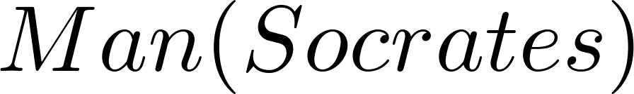
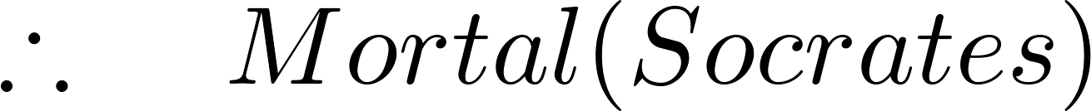
The Argument
We can express the premises or hypotheses (above the line) and the conclusion (below the line) in predicate logic as an argument:
We will see shortly that this is a valid argument.

Slide 7
Valid Arguments
We will show how to construct valid arguments in two stages; first for propositional logic and then for predicate logic. The rules of inference are the essential building block in the construction of valid arguments.
Propositional Logic
Inference Rules
Predicate Logic
Inference rules for propositional logic plus additional inference rules to handle variables and quantifiers.

Slide 8
Rules of Inference for Propositional Logic
An argument is valid if for all universes where its premises (or hypotheses) are true, its conclusion is also true.
The hypotheses therefore are filtering the set of universes: only universes where all the hypotheses are true are considered.
Definition of a counter-example. A counter-example of an argument is a universe where the premises of the argument are true and the conclusion is false.
An argument is valid if and only if it does not have any counter-example.

Slide 9
Rules of Inference for Propositional Logic
From the definition of the implication, a valid argument can be expressed by the fact that the following logical expression is a tautology.
let p₁, p₂, p₃, …, p_{m}, be the premises
let q be the conclusion
then
(p₁ ∧ p₂ ∧ p₃ ∧ … ∧ p_{m}) → q
should be a tautology for a valid argument
In fact, it is a tautology if and only if it is a valid argument.
We say that {p₁, p₂, p₃, …, p_{m}} logically implies q.
This corresponds to proving a theorem.

Slide 10
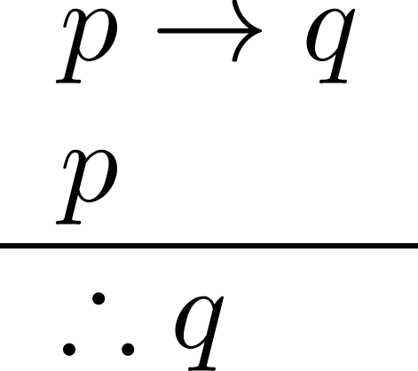
Rules of Inference for Propositional Logic: Modus Ponens
Corresponding Tautology:
(p ∧ (p →q)) → q
Example:
Let p be “It is snowing.”
Let q be “I will study discrete math.”
“If it is snowing, then I will study discrete math.”
“It is snowing.”
“Therefore , I will study discrete math.”

Slide 11
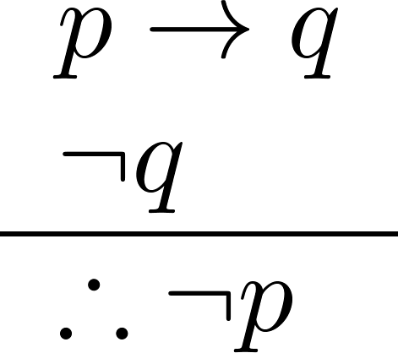
Modus Tollens
Corresponding Tautology:
(¬q∧(p →q))→¬p
Example:
Let p be “it is snowing.”
Let q be “I will study discrete math.”
“If it is snowing, then I will study discrete math.”
“I will not study discrete math.”
“Therefore , it is not snowing.”

Slide 12
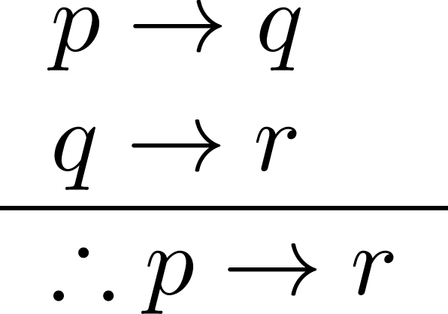
Hypothetical Syllogism
Corresponding Tautology:
((p →q) ∧ (q→r))→(p→ r)
Example:
Let p be “it snows.”
Let q be “I will study discrete math.”
Let r be “I will get an A.”
“If it snows, then I will study discrete math.”
“If I study discrete math, I will get an A.”
“Therefore , If it snows, I will get an A.”

Slide 13
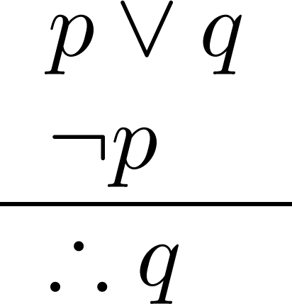
Disjunctive Syllogism
Corresponding Tautology:
(¬p∧(p ∨q))→q
Example:
Let p be “I will study discrete math.”
Let q be “I will study English literature.”
“I will study discrete math or I will study English literature.”
“I will not study discrete math.”
“Therefore , I will study English literature.”

Slide 14
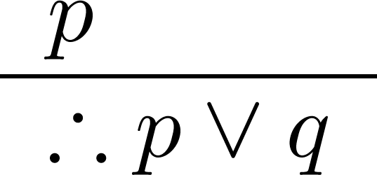
Addition
Corresponding Tautology:
p →(p ∨q)
Example:
Let p be “I will study discrete math.”
Let q be “I will visit Las Vegas.”
“I will study discrete math.”
“Therefore, I will study discrete math or I will visit
Las Vegas.”

Slide 15
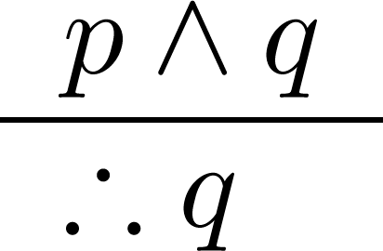
Simplification
Corresponding Tautology:
(p∧q) →q
Example:
Let p be “I will study discrete math.”
Let q be “I will study English literature.”
“I will study discrete math and English literature”
“Therefore, I will study discrete math.”

Slide 16
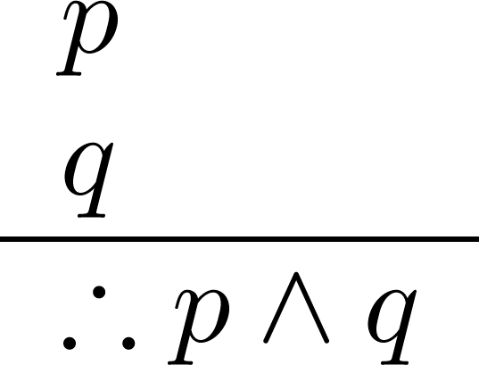
Conjunction
Corresponding Tautology:
((p) ∧ (q)) →(p ∧ q)
Example:
Let p be “I will study discrete math.”
Let q be “I will study English literature.”
“I will study discrete math.”
“I will study English literature.”
“Therefore, I will study discrete math and I will study English literature.”

Slide 17
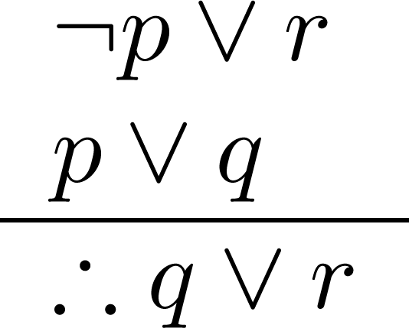
Resolution
Resolution plays an important role in AI and is used in Prolog.
Corresponding Tautology:
((¬p ∨ r ) ∧ (p ∨ q)) →(q ∨ r)
Example:
Let p be “I will study discrete math.”
Let r be “I will study English literature.”
Let q be “I will study databases.”
“I will not study discrete math or I will study English literature.”
“I will study discrete math or I will study databases.”
“Therefore, I will study databases or I will study English literature.”

Slide 18
Proof by contradiction
It can be shown that (¬p → F) → p, where F is the contradiction, is a tautology
So that, instead of proving p, one can prove that (¬p → F) is true instead
This could be useful when (¬p → F) is easier to prove than p
p | ¬p | F | ¬p → F | (¬p → F) → p
T | F | F | T | T
F | T | F | F | T

Slide 19
Proof by contradiction
More generally, if we have premises , p₁, p₂, p₃, …, p_{m}
And we want to prove (p₁ ∧ p₂ ∧ p₃ ∧ … ∧ p_{m}) → q, where q is the conclusion,
We can prove instead (p₁ ∧ p₂ ∧ p₃ ∧ … ∧ p_{m} ∧ ¬q) → F
Indeed, it can easily be shown that
(p → q) ↔ [(p ∧ ¬q) → F]
where p could be set to p = (p₁ ∧ p₂ ∧ p₃ ∧ … ∧ p_{m})
This is called proof by contradiction or reductio ad absurdum

Slide 20
Proof by contradiction
Indeed,
p | q | F | p ∧ ¬q | (p ∧ ¬q) → F | p → q | (p → q) ↔ [(p ∧ ¬q) → F]
F | F | F | F | T | T | T
F | T | F | F | T | T | T
T | F | F | T | F | F | T
T | T | F | F | T | T | T

Slide 21

Using the Rules of Inference to Build Valid Arguments
A valid argument is thus a sequence of statements. Each statement is either a premise or follows from previous statements by rules of inference.
The last statement is called conclusion.
A valid argument takes the following form:
S₁
S₂
.
.
.
S_{n}
C

Slide 22
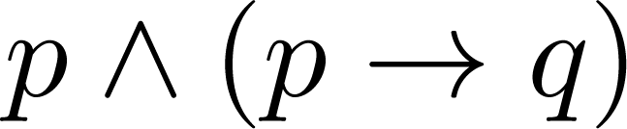
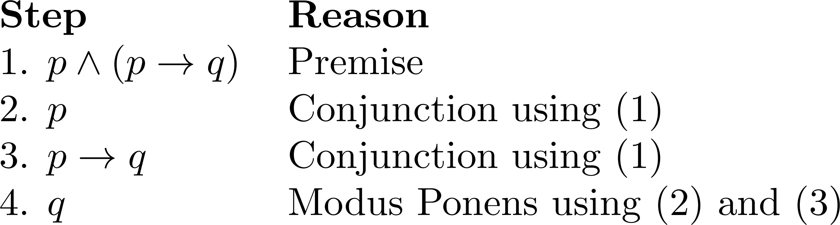
Valid Arguments
Example 1: From the single premise
Show that q is a conclusion.
Solution:

Slide 23
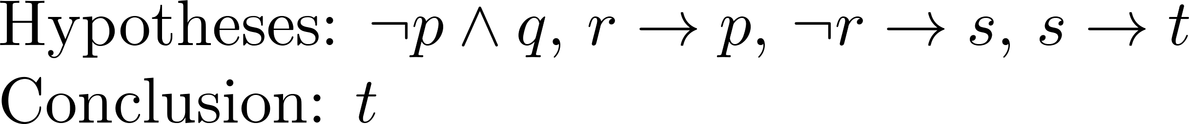
Valid Arguments
Example 2:
With these hypotheses:
“It is not sunny this afternoon and it is colder than yesterday.”
“We will go swimming only if it is sunny.”
“If we do not go swimming, then we will take a canoe trip.”
“If we take a canoe trip, then we will be home by sunset.”
Using the inference rules, construct a valid argument for the conclusion:
“We will be home by sunset.”
Solution:
Choose propositional variables:
p : “It is sunny this afternoon.” r : “We will go swimming.” t : “We will be home by sunset.”
q : “It is colder than yesterday.” s : “We will take a canoe trip.”
Translation into propositional logic:
Continued on next slide →

Slide 24
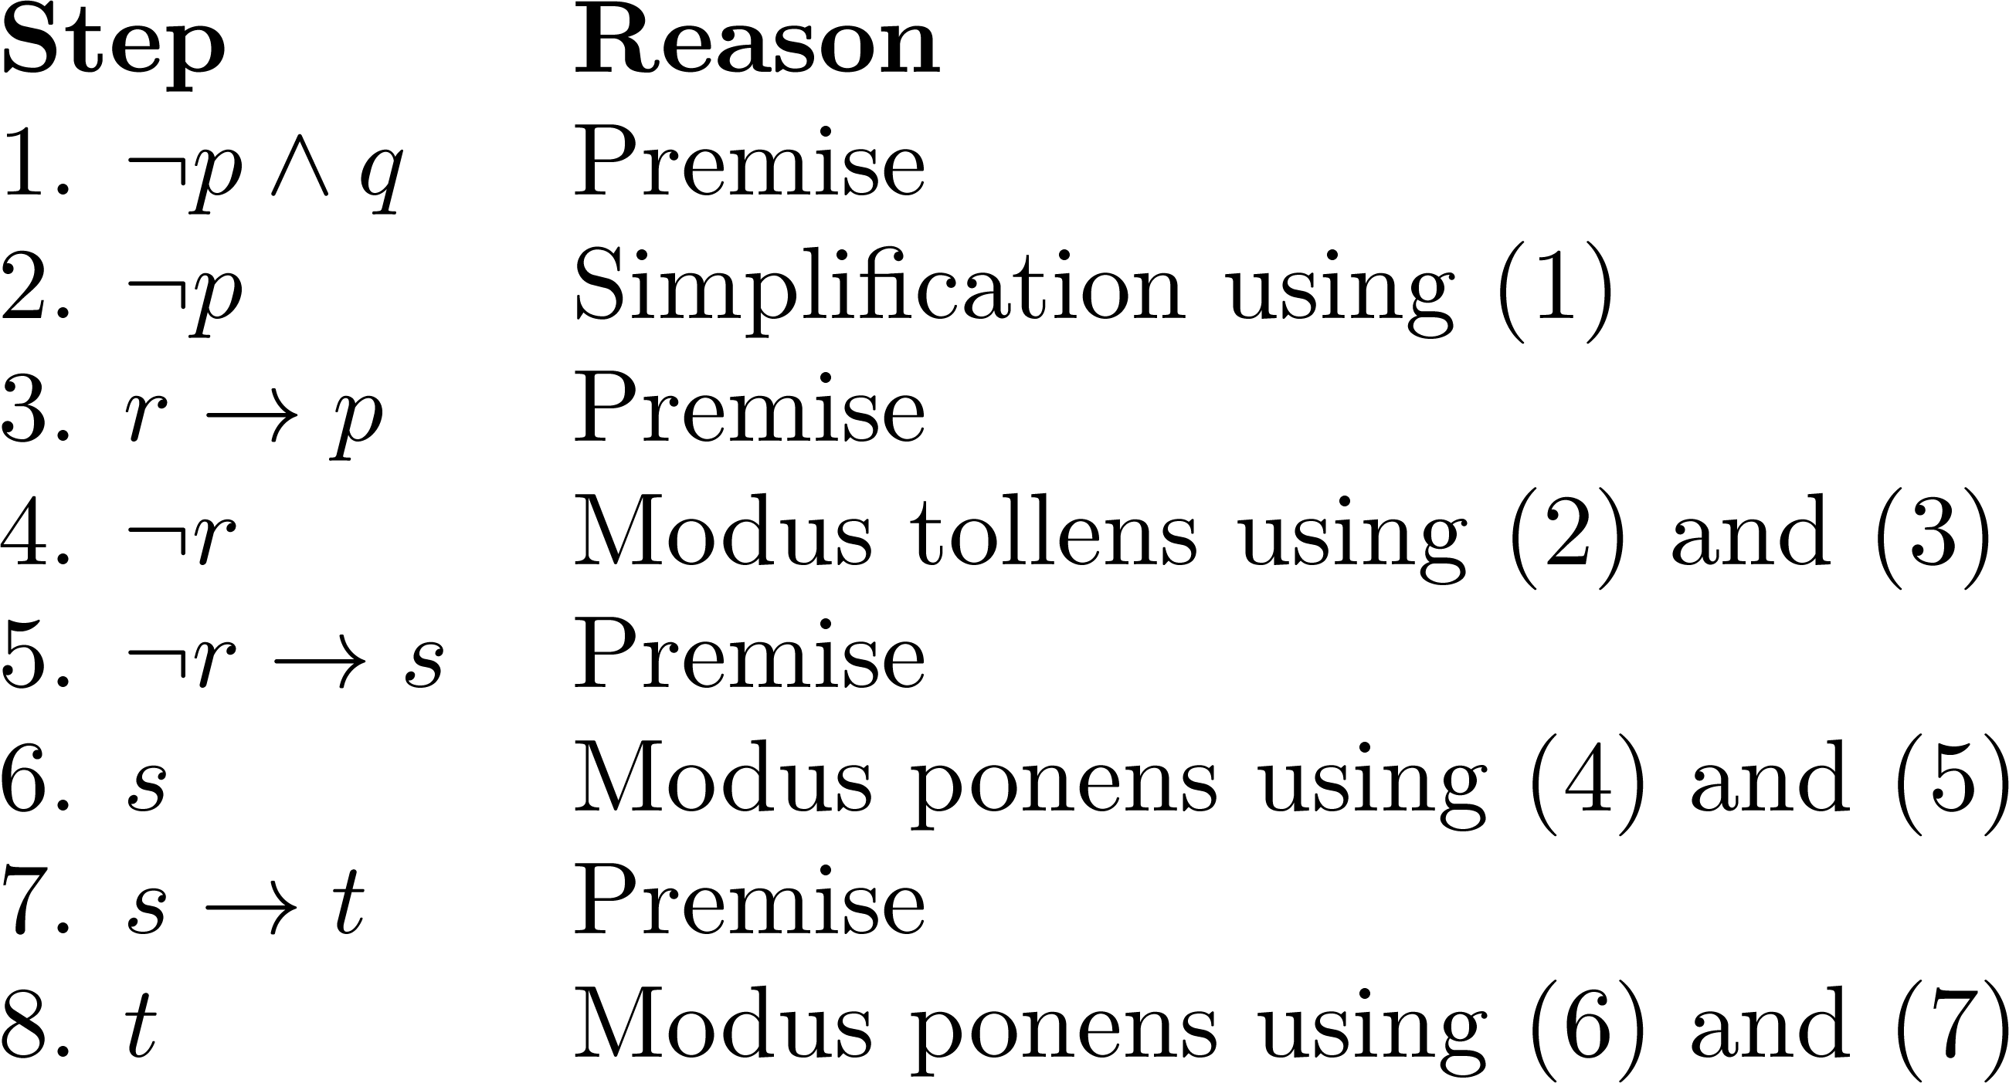
Valid Arguments
3. Construct the Valid Argument
Notes:
Note that a truth table would have 32 rows since we have 5 propositional variables.

Slide 25
Handling Quantified Statements
Valid arguments for quantified statements are a sequence of statements.
Each statement is either a premise or follows from previous statements by rules of inference which include:
Rules of Inference for Propositional Logic
Rules of Inference for Quantified Statements
The rules of inference for quantified statements are introduced in the next several slides.

Slide 26
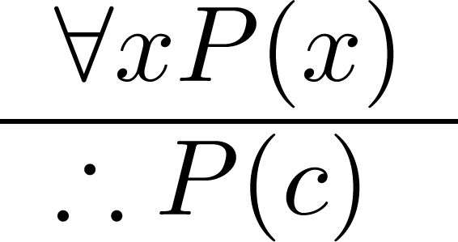
Universal Instantiation (UI)
Example:
Our domain consists of all dogs and Fido is a dog.
“All dogs are cuddly.”
“Therefore, Fido is cuddly.”

Slide 27
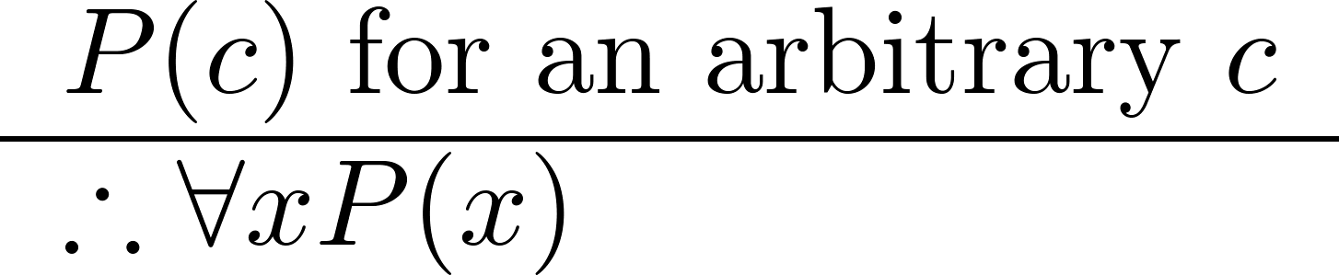
Universal Generalization (UG)
Used often implicitly in Mathematical Proofs.

Slide 28
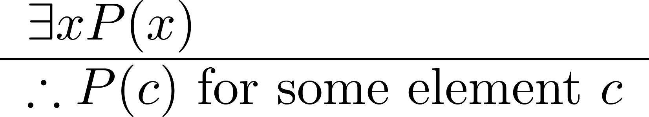
Existential Instantiation (EI)
Example:
“There is someone who got an A in the course.”
“Let’s call her a and say that a got an A”

Slide 29
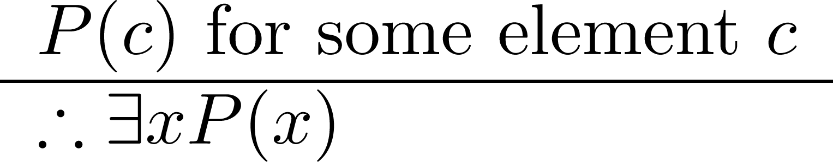
Existential Generalization (EG)
Example:
“Michelle got an A in the class.”
“Therefore, someone got an A in the class.”

Slide 30
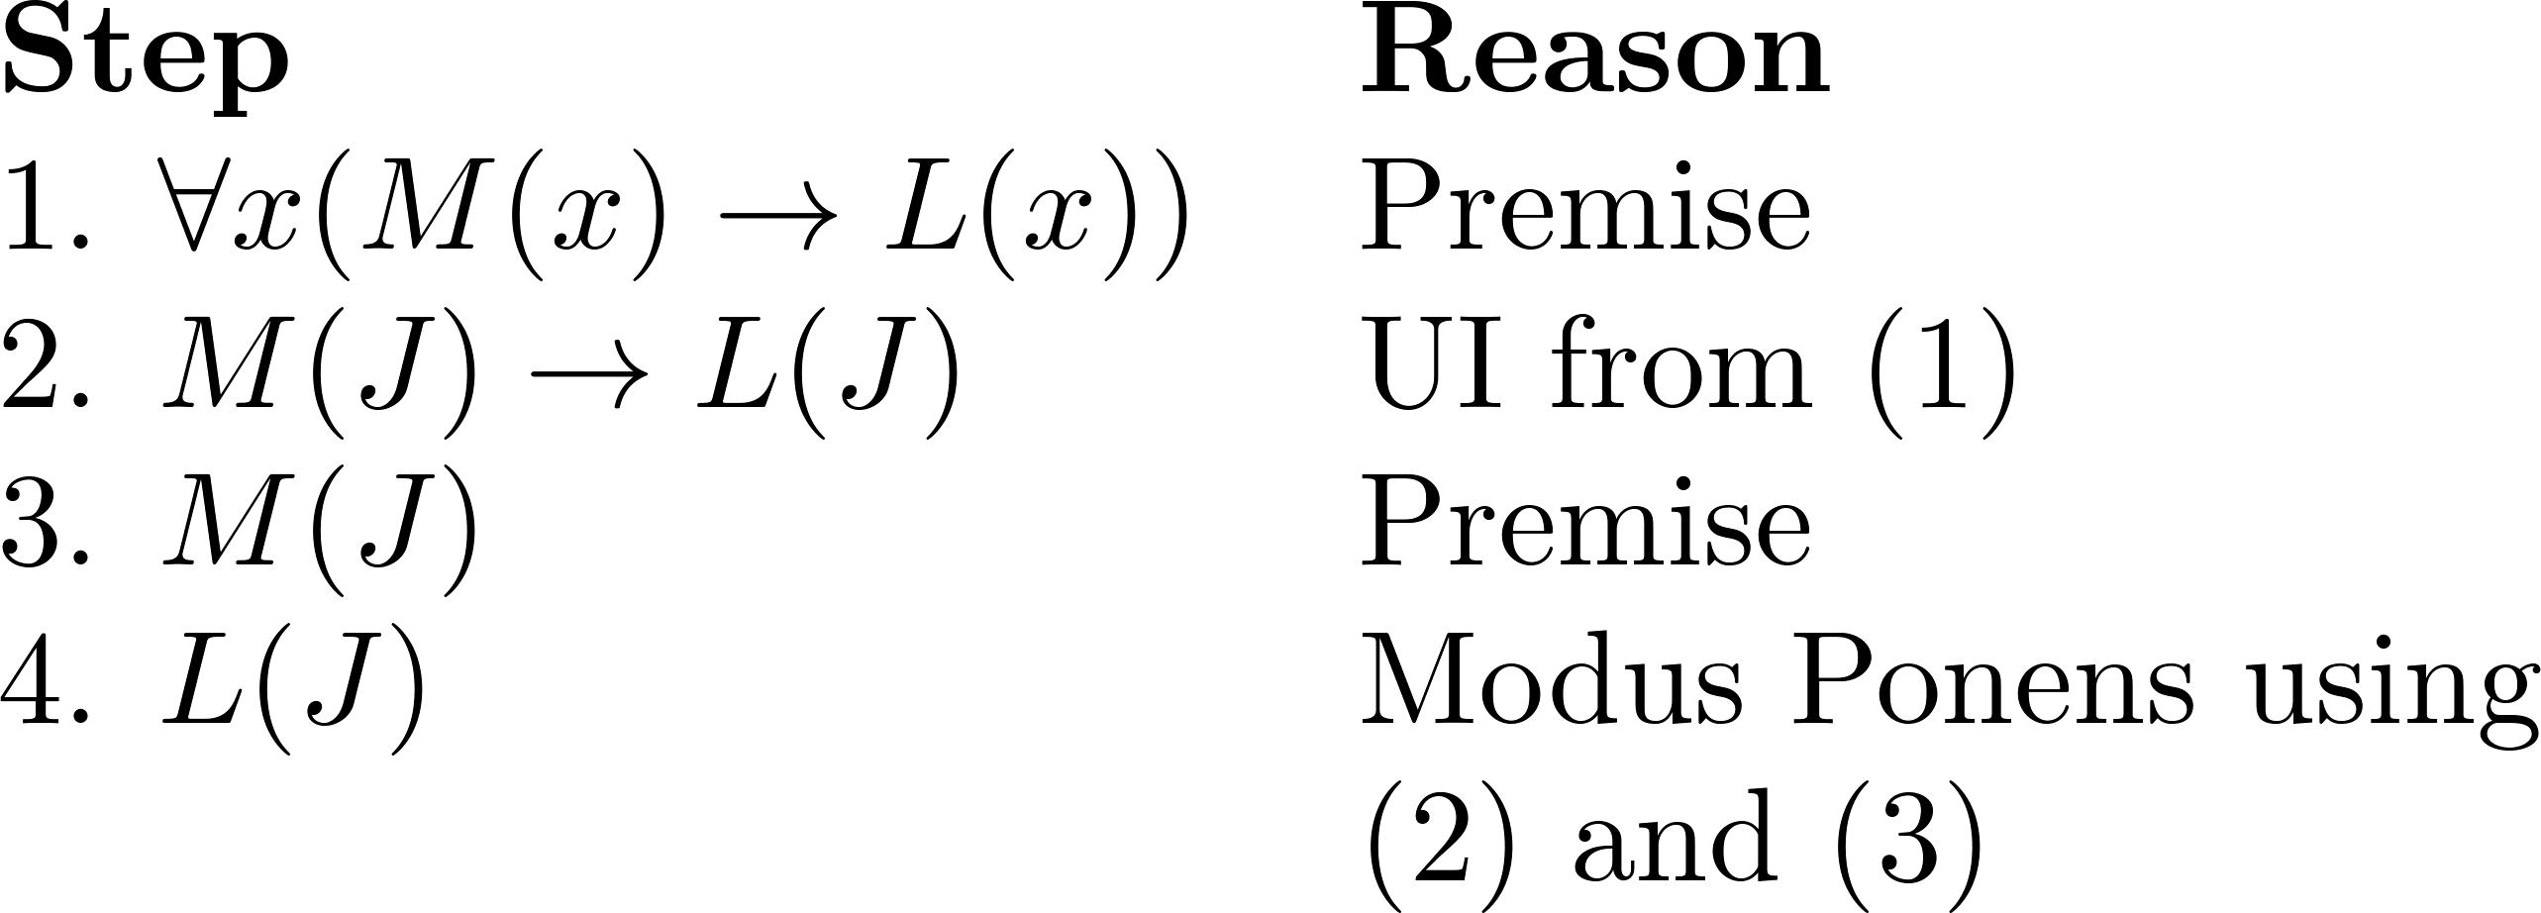
Using Rules of Inference
Example 1: Using the rules of inference, construct a valid argument to show that
“John Smith has two legs”
is a consequence of the premises:
“Every man has two legs.” “John Smith is a man.”
Solution: Let M(x) denote “x is a man” and L(x) “ x has two legs” and let John Smith be a member of the domain.
Valid Argument:

Slide 31
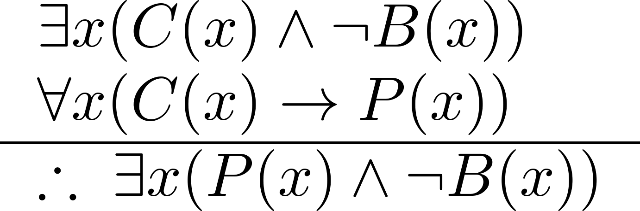
Using Rules of Inference
Example 2: Use the rules of inference to construct a valid argument showing that the conclusion
“Someone who passed the first exam has not read the book.”
follows from the premises
“A student in this class has not read the book.”
“Everyone in this class passed the first exam.”
Solution: Let C(x) denote “x is in this class,” B(x) denote “ x has read the book,” and P(x) denote “x passed the first exam.”
First we translate the
premises and conclusion
into symbolic form.
Continued on next slide →

Slide 32
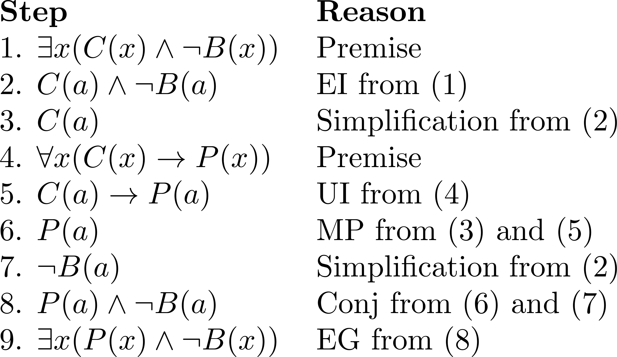
Using Rules of Inference
Valid Argument:

Slide 33
Returning to the Socrates Example

Slide 34
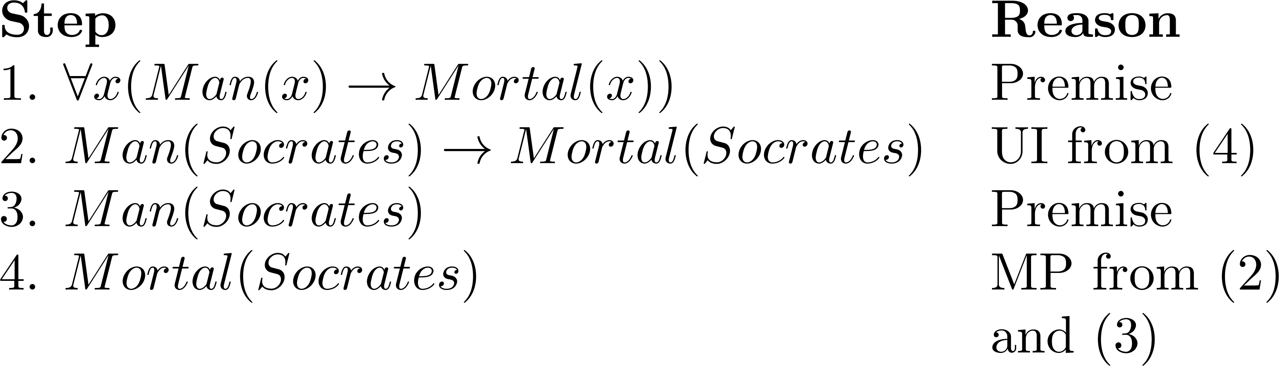
Solution for Socrates Example
Valid Argument

Slide 35
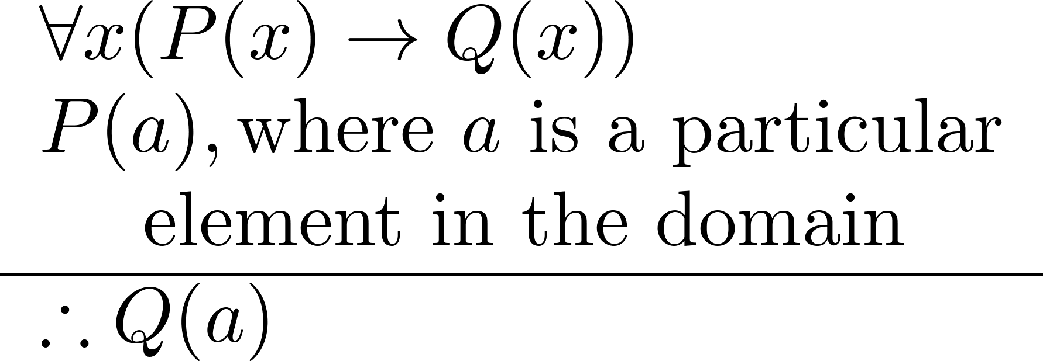
Universal Modus Ponens
Universal Modus Ponens combines universal instantiation and modus ponens into one rule.
This rule could be used in the Socrates example.

Slide 36
Normal Forms
Section 1.7
With Question/Answer Animations

Slide 37
Section Summary
Disjunctive Normal Form
Conjunctive Normal Form
Principal Disjunctive Normal Form
Principal Conjunctive Normal Form
Prenex Normal Form
(Normal form for first order logic)

Slide 38
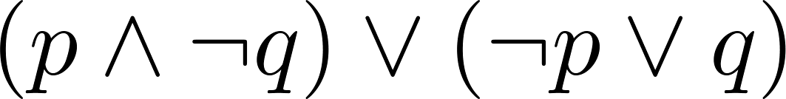
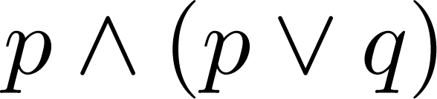
Disjunctive Normal Form (cont)
A propositional formula is in disjunctive normal form if it consists of a disjunction of (1, … ,n) disjuncts where each disjunct consists of a conjunction of (1, …, m) atomic formulas or the negation of an atomic formula. Are the following expression in DNF?
No
No
Yes
Disjunctive Normal Form is important for circuit design methods.

Slide 39
Disjunctive Normal Form (cont)
Example: Show that every compound proposition can be put in disjunctive normal form.
Solution: Construct the truth table for the proposition. Then an equivalent proposition is the disjunction with n disjuncts (where n is the number of rows for which the formula evaluates to T).
Each disjunct has m conjuncts where m is the number of distinct propositional variables. Each conjunct includes the positive form of the propositional variable if the variable is assigned T in that row and the negated form if the variable is assigned F in that row.
This proposition is in disjunctive normal from.

Slide 40
Disjunctive Normal Form (cont)
Example: Find the Disjunctive Normal Form (DNF) of
(p∨q)→¬r
Solution: This proposition is true when r is false or when both p and q are false.
(¬p∧ ¬q) ∨ ¬r

Slide 41
Conjunctive Normal Form (cont)
A compound proposition is in Conjunctive Normal Form (CNF) if it is a conjunction of disjunctions.
Every proposition can be put in an equivalent CNF.
Conjunctive Normal Form (CNF) can be obtained by eliminating implications, moving negation inwards and using the distributive and associative laws.
Important in resolution theorem proving used in artificial Intelligence (AI).
A compound proposition can be put in conjunctive normal form through repeated application of the logical equivalences covered earlier.

Slide 42
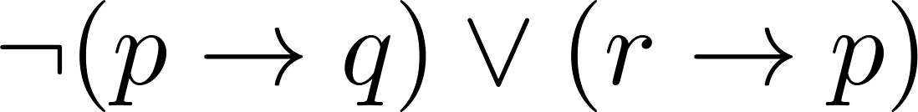
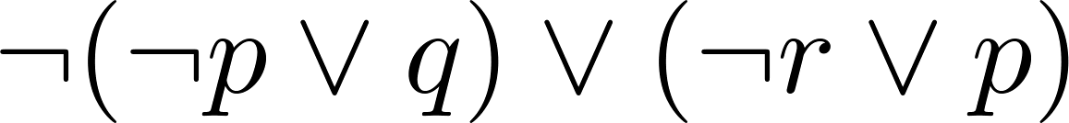
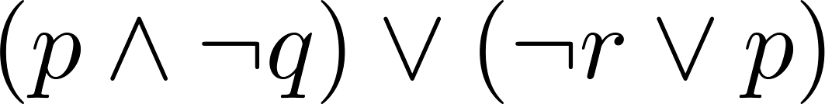
Conjunctive Normal Form (cont)
Example: Put the following into CNF:
Solution:
Eliminate implication signs:
Move negation inwards; eliminate double negation:
Convert to CNF using associative/distributive laws

Slide 43
Principal Disjunctive Normal Form
Let p and q be propositional variables. Consider the four conjunctions given below.
p ∧ q, p ∧ ¬q, ¬p ∧ q, ¬p ∧ ¬q
represent conjunctions in which p or ¬p appears as also q or ¬q. Each variable occurs either negated or non negated, but both negated and non negated forms of a variable do not occur together in the conjunction. Also p ∧ q and q ∧ p are treated as the same. These four conjunctions are called minterms of p and q.
In general if there are n variables, there will be 2^{n} minterms. Each minterm is a conjunction in which each variable occurs once either in the negated form or in the non negated form.

Slide 44
Definition
For a given formula, an equivalent formula consisting of disjunctions of minterms only is known as its principal disjunctive normal form. Such a normal form is also called sum-of-products canonical form.

Slide 45
Consider the following truth table

Slide 46
Consider the truth table for p → q and p ↔ q
The principal disjunctive normal form for p → q will be (p ∧ q) ∨ (¬p ∧ q) ∨ (¬p ∧ ¬q). This disjunction corresponds to the disjunction of these minterms having T in the respective rows. Similarly p ↔ q has the following principal disjunctive normal form (p ∧ q) ∨ (¬p ∧ ¬q).

Slide 47
In order to obtain the principal disjunctive normal form of a given formula without constructing its truth table, one may first replace implication (→) and equivalence (↔) by using ∧, ∨, ¬.
Then De Morgan's laws are used wherever necessary and distributive laws are also used in bringing to disjunctive normal form. An elementary product which is a contradiction is dropped.
Minterms are obtained in the disjunctions by introducing the missing factors. Duplications are avoided.

Slide 48
Example:
Obtain principal disjunctive normal form for p ∨ ¬q
Solution:
p ∨ ¬q = [p ∧ (q ∨ ¬q)] ∨ [¬q ∧ (p ∨ ¬p)]
= (p ∧ q) ∨ (p ∧ ¬q) ∨ (¬q ∧ p) ∨ (¬q ∧ ¬p)
= (p ∧ q) ∨ (p ∧ ¬q) ∨ (¬p ∧ ¬q)

Slide 49
Example: Obtain principal disjunctive normal form for
(p ∧ q) ∨ (¬p ∧ r) ∨ (q ∧ r)
Solution:
(p ∧ q) = (p ∧ q) ∧ (r ∨ ¬r)
= (p ∧ q ∧ r) ∨ (p ∧ q ∧ ¬r)
(¬p ∧ r) = (¬p ∧ r) ∧ (q ∨ ¬q)
= (¬p ∧ r ∧ q) ∨ (¬p ∧ r ∧ ¬q)
= (¬p ∧ q ∧ r) ∨ (¬p ∧ ¬q ∧ r)
(q ∧ r) = (q ∧ r) ∧ (p ∨ ¬p)
= (q ∧ r ∧ p) ∨ (q ∧ r ∧ ¬p)
= (p ∧ q ∧ r) ∨ (¬p ∧ q ∧ r)
Avoiding duplication, the given expression is equivalent to
(p ∧ q ∧ r) ∨ (p ∧ q ∧ ¬r) ∨ (¬p ∧ q ∧ r) ∨ (¬p ∧ ¬q ∧ r)

Slide 50
Principal Conjunctive Normal Form
We define maxterm as a dual to minterm. For a given number of variables, the maxterm consists of disjunctions in which each variable or its negation, but not both, appears only once. It can be seen that each of the maxterms has the truth value F for exactly one combination of the truth values of the variables. This is illustrated for two variables below:

Slide 51
Definition
For a given formula, an equivalent formula consisting of conjunction of maxterms only is known as its principal conjunctive normal form. This normal form is also called the product of sums canonical form.

Slide 52
Example:
Find principal conjunctive normal form for (p ↔ q)
Solution:
p ↔ q = (p → q) ∧ (q → p)
= (¬p ∨ q) ∧ (¬q ∨ p)

Slide 53
Example: Find principal conjunctive normal form for
[(p ∨ q) ∧ ¬p → ¬q]
Solution:
[(p ∨ q) ∧ ¬p → ¬q] = [(p ∧ ¬p) ∨ (q ∧ ¬p)] → ¬q
= (q ∧ ¬p) → ¬q
= ¬(q ∧ ¬p) ∨ ¬q
= ¬q ∨ ¬p ∨ ¬q
= ¬q ∨ p
= p ∨ ¬q

Slide 54
Definition
A formula F in the first order logic is said to be in a prenex normal form if and only if the formula F is in the form of (Q₁x₁)…(Q_{n}x_{n})(M) where every (Q_{i}x_{i}), i = 1, …n is either (∀ x_{i}) or (∃ x_{i}), and M is a formula containing no quantifiers.
(Q₁x₁)…(Q_{n}x_{n}) is called the prefix and M is called the matrix of the formula F.

Slide 55
Example
(∀ x)(∀ y)(P(x, y) ∧ Q(y))
∀ x ∃ y ∀ z(Q(x, y) → R(z)) are in prenex normal form.

Slide 56
Let us now see how to convert a given formula in first order logic to prenex normal form.
We denote two formulas F₁, F₂ as equivalent by F₁ ↔ F₂ if and only if the truth values of F and G are the same under every interpretations.
We know that
¬ ∀ x P(x) ↔ ∃ x ¬P(x) (1)
¬ ∃ x P(x) ↔ ∀ x ¬P(x) (2)
Also ∀ distributes over ∧ and ∃ over ∨.
∀ does not distribute over ∨ and ∃ over ∧.
Also if F has a variable x and G does not contain x, then
(Qx)F(x) ∨ G ↔ Q(x)(F(x) ∨ G) (3)
(Qx)F(x) ∧ G ↔ Q(x)(F(x) ∧ G) (4)

Slide 57
We see that if F₁ and F₂ have variable x,
(∀x F₁(x)) ∨ (∀x F₂(x)) ≠ ∀x (F₁(x) ∨ F₂(x))
But in F₂(x) we can rename the variable x as z and get ∀x F₁(x) ∨ ∀z F₂(z) which can be brought to the form ∀x ∀z (F₁(x) ∨ F₂(z)). Note that F₂ does not contain x and F₁ does not contain z.
Similarly, ∃x F₁(x) ∧ ∃x F₂(x) can be brought to the following form by renaming of variable x as z in F₂.
∃x F₁(x) ∧ ∃x F₂(x)
= ∃x F₁(x) ∧ ∃z F₂(z)
= ∃x ∃z (F₁(x) ∧ F₂(z))

Slide 58
Hence it is possible to bring the quantifiers to the left of the formula. The following steps are carried out to bring a formula of first order logic to prenex normal form:
Step 1: Replace ↔ and → using ∧, ∨, ¬
Step 2: Use double negation and De Morgan's laws
repeatedly and the laws (1) and (2).
Step 3: Rename variables if necessary
Step 4: Use rules (3) and (4) to bring the quantifiers to
the left.

Slide 59
Example:
Transform the formula into prenex normal form:
∀x P(x) → ∃x Q(x)
Solution:
∀x P(x) → ∃x Q(x)
¬ ∀x P(x) ∨ ∃x Q(x)
∃x (¬P(x)) ∨ ∃x Q(x)
∃x (¬P(x)) ∨ ∃x Q(x)
∃x (¬P(x) ∨ Q(x))

Slide 60
Example: Obtain prenex normal form for the formula
(∀ x)(∀ y)((∃ z)(P(x, z) ∧ P(y, z)) → (∃ u)Q(x, y, u))
Solution:
(∀ x)(∀ y)(¬ (∃ z)(P(x, z) ∧ P(y, z)) ∨ (∃ u)Q(x, y, u))
(∀ x)(∀ y)((∀ z) ¬(P(x, z) ∧ P(y, z)) ∨ (∃ u)Q(x, y, u))
(∀ x)(∀ y)((∀ z)(¬P(x, z) ∨ ¬P(y, z)) ∨ (∃ u)Q(x, y, u))
(∀ x)(∀ y)(∀ z)(∃ u)((¬P(x, z) ∨ ¬P(y, z)) ∨ Q(x, y, u))

Slide 61
Proofs: more advanced material
Section 1.8

Slide 62
Section Summary
Mathematical Proofs
Forms of Theorems
Direct Proofs
Indirect Proofs
Proof of the Contrapositive
Proof by Contradiction

Slide 63
Proofs of Mathematical Statements
A proof is a valid argument that establishes the truth of a statement.
In math, CS, and other disciplines, informal proofs which are generally shorter, are generally used.
More than one rule of inference are often used in a step.
Steps may be skipped.
The rules of inference used are not explicitly stated.
Easier for to understand and to explain to people.
But it is also easier to introduce errors.
Proofs have many practical applications:
verification that computer programs are correct
establishing that operating systems are secure
enabling programs to make inferences in artificial intelligence
showing that system specifications are consistent

Slide 64
Definitions
A theorem is a statement that can be shown to be true using:
definitions
other theorems
axioms (statements which are given as true)
rules of inference
A lemma is a ‘helping theorem’ or a result which is needed to prove a theorem.
A corollary is a result which follows directly from a theorem.
Less important theorems are sometimes called propositions.
A conjecture is a statement that is being proposed to be true. Once a proof of a conjecture is found, it becomes a theorem. It may turn out to be false.

Slide 65
Forms of Theorems
Many theorems assert that a property holds for all elements in a domain, such as the integers, the real numbers, or some of the discrete structures that we will study in this class.
Often the universal quantifier (needed for a precise statement of a theorem) is omitted by standard mathematical convention.
For example, the statement:
“If x > y, where x and y are positive real numbers, then x² > y² ”
really means
“For all positive real numbers x and y, if x > y, then x² > y² .”

Slide 66
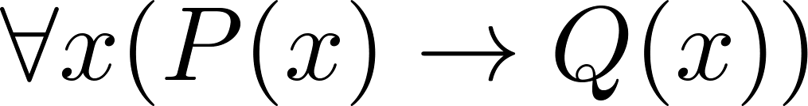
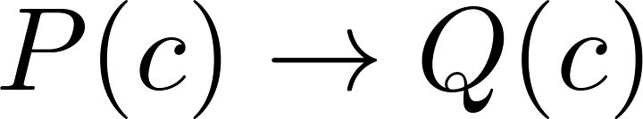

Proving Theorems
Many theorems have the form:
To prove them, we show that where c is an arbitrary element of the domain,
By universal generalization the truth of the original formula follows.
So, we must prove something of the form:

Slide 67
Proving Conditional Statements: p → q
Trivial Proof: If we know q is true, then
p → q is true as well.
“If it is raining then 1=1.”
Vacuous Proof: If we know p is false then
p → q is true as well.
“If I am both rich and poor then 2 + 2 = 5.”
[ Even though these examples seem silly, both trivial and vacuous proofs are often used in mathematical induction, as we will see in Chapter 5) ]

Slide 68
Even and Odd Integers
Definition: The integer n is even if there exists an integer k such that n = 2k, and n is odd if there exists an integer k, such that n = 2k + 1. Note that every integer is either even or odd and no integer is both even and odd.
We will need this basic fact about the integers in some of the example proofs to follow. We will learn more about the integers in Chapter 4.

Slide 69
Proving Conditional Statements: p → q
Direct Proof: Assume that p is true. Use rules of inference, axioms, and logical equivalences to show that q must also be true.
Example: Give a direct proof of the theorem “If n is an odd integer, then n² is odd.”
Solution: Assume that n is odd. Then n = 2k + 1 for an integer k. Squaring both sides of the equation, we get:
n² = (2k + 1)² = 4k² + 4k +1 = 2(2k² + 2k) + 1= 2r + 1,
where r = 2k² + 2k , an integer.
We have proved that if n is an odd integer, then n² is an odd integer.
( marks the end of the proof. Sometimes QED is used instead. )

Slide 70
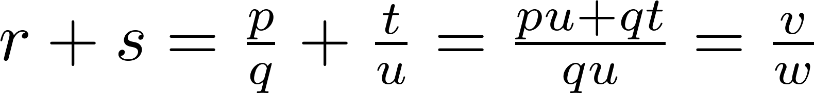
Proving Conditional Statements: p → q
Definition: The real number r is rational if there exist integers p and q where q≠0 such that r = p/q
Example: Prove that the sum of two rational numbers is rational.
Solution: Assume r and s are two rational numbers. Then there must be integers p, q and also t, u such that
Thus the sum is rational.
where v = pu + qt
w = qu ≠ 0

Slide 71
Proving Conditional Statements: p → q
Proof by Contraposition: Assume ¬q and show ¬p is true also. This is sometimes called an indirect proof method. If we give a direct proof of ¬q → ¬p then we have a proof of p → q.
Why does this work?
Example: Prove that if n is an integer and 3n + 2 is odd, then n is odd.
Solution: Assume n is even. So, n = 2k for some integer k. Thus
3n + 2 = 3(2k) + 2 =6k +2 = 2(3k + 1) = 2j for j = 3k +1
Therefore 3n + 2 is even. Since we have shown ¬q → ¬p , p → q must hold as well. If n is an integer and 3n + 2 is odd (not even) , then n is odd (not even).

Slide 72
Proving Conditional Statements: p → q
Example: Prove that for an integer n, if n² is odd, then n is odd.
Solution: Use proof by contraposition. Assume n is even (i.e., not odd). Therefore, there exists an integer k such that n = 2k. Hence,
n² = 4k² = 2 (2k²)
and n² is even(i.e., not odd).
We have shown that if n is an even integer, then n² is even. Therefore by contraposition, for an integer n, if n² is odd, then n is odd.

Slide 73
Proving Conditional Statements: p → q
Proof by Contradiction: (AKA reductio ad absurdum).
To prove p, assume ¬p and derive a contradiction such as p ∧ ¬p. (an indirect form of proof). Since we have shown that ¬p →F is true , it follows that the contrapositive T→p also holds.
Example: Prove that if you pick 22 days from the calendar, at least 4 must fall on the same day of the week.
Solution: Assume that no more than 3 of the 22 days fall on the same day of the week. Because there are 7 days of the week, we could only have picked 21 days. This contradicts the assumption that we have picked 22 days.

Slide 74
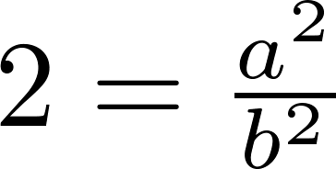
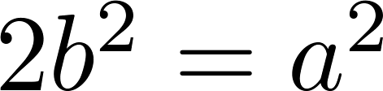
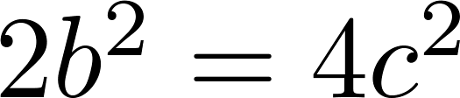
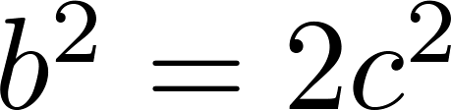
Proof by Contradiction
A preview of Chapter 4.
Example: Use a proof by contradiction to give a proof that √2 is irrational.
Solution: Suppose √2 is rational. Then there exists integers a and b with √2 = a/b, where b≠ 0 and a and b have no common factors (see Chapter 4). Then
Therefore a² must be even. If a² is even then a must be even (an exercise). Since a is even, a = 2c for some integer c. Thus,
Therefore b² is even. Again then b must be even as well.
But then 2 must divide both a and b. This contradicts our assumption that a and b have no common factors. We have proved by contradiction that our initial assumption must be false and therefore √2 is irrational .

Slide 75
Proof by Contradiction
A preview of Chapter 4.
Example: Prove that there is no largest prime number.
Solution: Assume that there is a largest prime number. Call it p_{n}. Hence, we can list all the primes 2,3,.., p_{n}. Form
None of the prime numbers on the list divides r. Therefore, by a theorem in Chapter 4, either r is prime or there is a smaller prime that divides r. This contradicts the assumption that there is a largest prime. Therefore, there is no largest prime.

Slide 76
Theorems that are Biconditional Statements
To prove a theorem that is a biconditional statement, that is, a statement of the form p ↔ q, we show that p → q and q →p are both true.
Example: Prove the theorem: “If n is an integer, then n is odd if and only if n² is odd.”
Solution: We have already shown (previous slides) that both p →q and q →p. Therefore we can conclude p ↔ q.
Sometimes iff is used as an abbreviation for “if an only if,” as in
“If n is an integer, then n is odd iif n² is odd.”

Slide 77
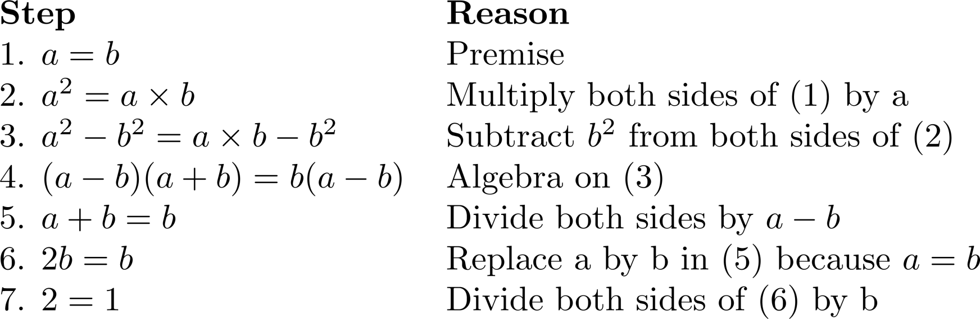
What is wrong with this?
“Proof” that 1 = 2
Solution: Step 5. a - b = 0 by the premise and division by 0 is undefined.

Slide 78
Looking Ahead
If direct methods of proof do not work:
We may need a clever use of a proof by contraposition.
Or a proof by contradiction.
In the next section, we will see strategies that can be used when straightforward approaches do not work.
In Chapter 5, we will see mathematical induction and related techniques.
In Chapter 6, we will see combinatorial proofs

Slide 79
Proof Methods and Strategy
Section 1.9

Slide 80
Section Summary
Proof by Cases
Existence Proofs
Constructive
Nonconstructive
Disproof by Counterexample
Nonexistence Proofs
Uniqueness Proofs
Proof Strategies
Proving Universally Quantified Assertions
Open Problems

Slide 81
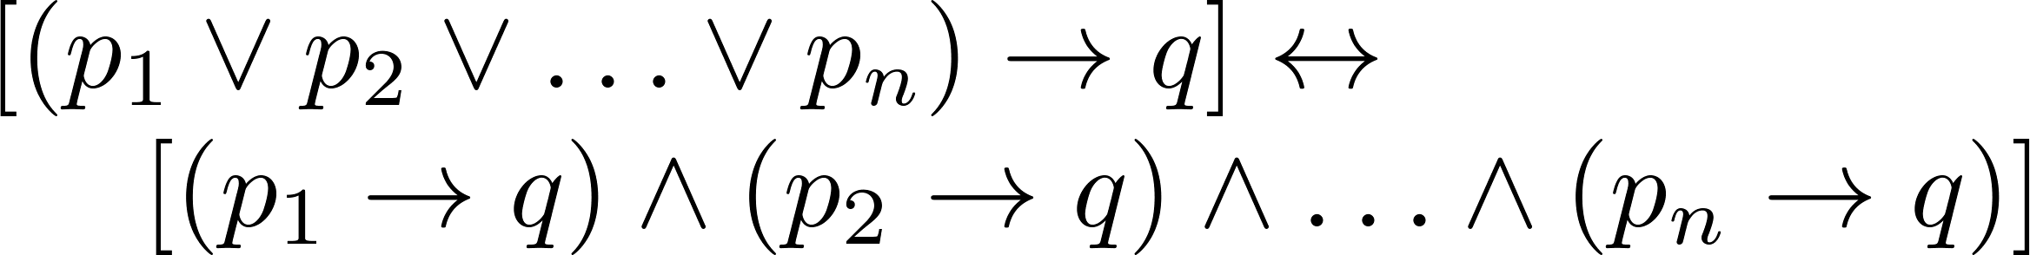

Proof by Cases
To prove a conditional statement of the form:
Use the tautology
Each of the implications is a case.

Slide 82
Proof by Cases
Example: Let a @ b = max{a, b} = a if a ≥ b, otherwise a @ b = max{a, b} = b.
Show that for all real numbers a, b, c
(a @b) @ c = a @ (b @ c)
(This means the operation @ is associative.)
Proof: Let a, b, and c be arbitrary real numbers.
Then one of the following 6 cases must hold.
a ≥ b ≥ c
a ≥ c ≥ b
b ≥ a ≥c
b ≥ c ≥a
c ≥ a ≥ b
c ≥ b ≥ a
Continued on next slide →

Slide 83
Proof by Cases
Case 1: a ≥ b ≥ c
(a @ b) = a, a @ c = a, b @ c = b
Hence (a @ b) @ c = a = a @ (b @ c)
Therefore the equality holds for the first case.
A complete proof requires that the equality be shown to hold for all 6 cases. But the proofs of the remaining cases are similar. Try them.

Slide 84
Without Loss of Generality
Example: Show that if x and y are integers and both x∙y and x+y are even, then both x and y are even.
Proof: Use a proof by contraposition. Suppose x and y are not both even. Then, one or both are odd. Without loss of generality, assume that x is odd. Then x = 2m + 1 for some integer k.
Case 1: y is even. Then y = 2n for some integer n, so x + y = (2m + 1) + 2n = 2(m + n) + 1 is odd.
Case 2: y is odd. Then y = 2n + 1 for some integer n, so x ∙ y = (2m + 1) (2n + 1) = 2(2m ∙ n +m + n) + 1 is odd.
We only cover the case where x is odd because the case where y is odd is similar. The use phrase without loss of generality (WLOG) indicates this.

Slide 85
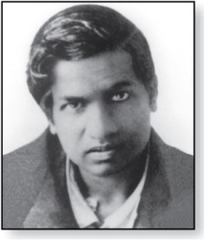
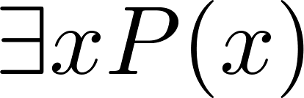
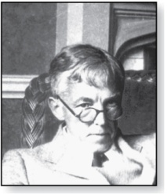
Existence Proofs
Srinivasa Ramanujan
(1887-1920)
Proof of theorems of the form .
Constructive existence proof:
Find an explicit value of c, for which P(c) is true.
Then is true by Existential Generalization (EG).
Example: Show that there is a positive integer that can be written as the sum of cubes of positive integers in two different ways:
Proof: 1729 is such a number since
1729 = 10³ + 9³ = 12³ + 1³
Godfrey Harold Hardy
(1877-1947)

Slide 86
Nonconstructive Existence Proofs
In a nonconstructive existence proof, we assume no c exists which makes P(c) true and derive a contradiction.
Example: Show that there exist irrational numbers x and y such that x^{y} is rational.
Proof: We know that √2 is irrational. Consider the number √2 ^{√2} . If it is rational, we have two irrational numbers x and y with x^{y} rational, namely x = √2 and y = √2. But if √2 ^{√2} is irrational, then we can let x = √2 ^{√2} and y = √2 so that aaaaa x^{y} = (√2 ^{√2} )^{√2} = √2 ^{(√2 √2)} = √2 ² = 2.

Slide 87
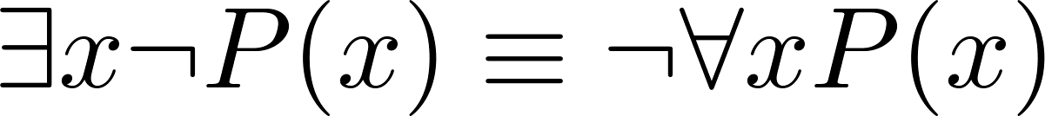
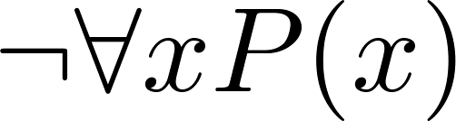
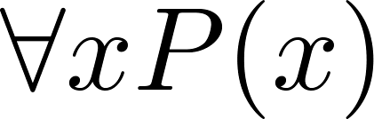
Counterexamples
Recall .
To establish that is true (or is false) find a c such that ¬P(c) is true or P(c) is false.
In this case c is called a counterexample to the assertion .
Example: “Every positive integer is the sum of the squares of 3 integers.” The integer 7 is a counterexample. So the claim is false.

Slide 88
Uniqueness Proofs
Some theorems asset the existence of a unique element with a particular property, ∃!x P(x). The two parts of a uniqueness proof are
Existence: We show that an element x with the property exists.
Uniqueness: We show that if y≠x, then y does not have the property.
Example: Show that if a and b are real numbers and a ≠0, then there is a unique real number r such that ar + b = 0.
Solution:
Existence: The real number r = −b/a is a solution of ar + b = 0 because a(−b/a) + b = −b + b =0.
Uniqueness: Suppose that s is a real number such that as + b = 0. Then ar + b = as + b, where r = −b/a. Subtracting b from both sides and dividing by a shows that r = s.

Slide 89
Proof Strategies for proving p → q
Choose a method.
First try a direct method of proof.
If this does not work, try an indirect method (e.g., try to prove the contrapositive).
For whichever method you are trying, choose a strategy.
First try forward reasoning. Start with the axioms and known theorems and construct a sequence of steps that end in the conclusion. Start with p and prove q, or start with ¬q and prove ¬p.
If this doesn’t work, try backward reasoning. When trying to prove q, find a statement p that we can prove with the property p → q.

Slide 90
Backward Reasoning
Example: Suppose that two people play a game taking turns removing, 1, 2, or 3 stones at a time from a pile that begins with 15 stones. The person who removes the last stone wins the game. Show that the first player can win the game no matter what the second player does.
Proof: Let n be the last step of the game.
Step n: Player₁ can win if the pile contains 1,2, or 3 stones.
Step n-1: Player₂ will have to leave such a pile if the pile that he/she is faced with has 4 stones.
Step n-2: Player₁ can leave 4 stones when there are 5,6, or 7 stones left at the beginning of his/her turn.
Step n-3: Player₂ must leave such a pile, if there are 8 stones .
Step n-4: Player₁ has to have a pile with 9,10, or 11 stones to ensure that there are 8 left.
Step n-5: Player₂ needs to be faced with 12 stones to be forced to leave 9,10, or 11.
Step n-6: Player₁ can leave 12 stones by removing 3 stones.
Now reasoning forward, the first player can ensure a win by removing 3 stones and leaving 12.

Slide 91

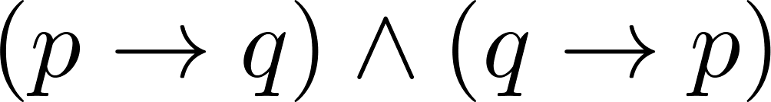
Universally Quantified Assertions
To prove theorems of the form ,assume x is an arbitrary member of the domain and show that P(x) must be true. Using UG it follows that .
Example: An integer x is even if and only if x² is even.
Solution: The quantified assertion is
∀x [x is even ↔ x² is even]
We assume x is arbitrary.
Recall that is equivalent to
So, we have two cases to consider. These are considered in turn.
Continued on next slide →

Slide 92
Universally Quantified Assertions
Case 1. We show that if x is even then x² is even using a direct proof (the only if part or necessity).
If x is even then x = 2k for some integer k.
Hence x² = 4k² = 2(2k² ) which is even since it is an integer divisible by 2.
This completes the proof of case 1.
Case 2 on next slide →

Slide 93
Universally Quantified Assertions
Case 2. We show that if x² is even then x must be even (the if part or sufficiency). We use a proof by contraposition.
Assume x is not even and then show that x² is not even.
If x is not even then it must be odd. So, x = 2k + 1 for some k. Then x² = (2k + 1)² = 4k² + 4k + 1 = 2(2k² + 2k) + 1
which is odd and hence not even. This completes the proof of case 2.
Since x was arbitrary, the result follows by UG.
Therefore we have shown that x is even if and only if x² is even.

Slide 94

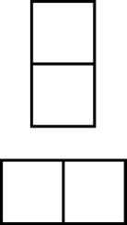

Proof and Disproof: Tilings
Example 1: Can we tile the standard checkerboard using dominos?
Solution: Yes! One example provides a constructive existence proof.
Two Dominoes
The Standard Checkerboard
One Possible Solution

Slide 95
Tilings
Example 2: Can we tile a checkerboard obtained by removing one of the four corner squares of a standard checkerboard?
Solution:
Our checkerboard has 64 − 1 = 63 squares.
Since each domino has two squares, a board with a tiling must have an even number of squares.
The number 63 is not even.
We have a contradiction.

Slide 96

Tilings
Example 3: Can we tile a board obtained by removing both the upper left and the lower right squares of a standard checkerboard?
Nonstandard Checkerboard
Dominoes
Continued on next slide →

Slide 97
Tilings
Solution:
There are 62 squares in this board.
To tile it we need 31 dominos.
Key fact: Each domino covers one black and one white square.
Therefore the tiling covers 31 black squares and 31 white squares.
Our board has either 30 black squares and 32 white squares or 32 black squares and 30 white squares.
Contradiction!

Slide 98
The Role of Open Problems
Unsolved problems have motivated much work in mathematics. Fermat’s Last Theorem was conjectured more than 300 years ago. It has only recently been finally solved.
Fermat’s Last Theorem: The equation x^{n} + y^{n} = z^{n}
has no solutions in integers x, y, and z, with xyz≠0 whenever n is an integer with n > 2.
A proof was found by Andrew Wiles in the 1990s.

Slide 99
An Open Problem
The 3x + 1 Conjecture: Let T be the transformation that sends an even integer x to x/2 and an odd integer x to 3x + 1. For all positive integers x, when we repeatedly apply the transformation T, we will eventually reach the integer 1.
For example, starting with x = 13:
T(13) = 3∙13 + 1 = 40, T(40) = 40/2 = 20, T(20) = 20/2 = 10,
T(10) = 10/2 = 5, T(5) = 3∙5 + 1 = 16,T(16) = 16/2 = 8,
T(8) = 8/2 = 4, T(4) = 4/2 = 2, T(2) = 2/2 = 1
The conjecture has been verified using computers up to 5.6 ∙ 10¹³ .

Slide 100
Additional Proof Methods
Later we will see many other proof methods:
Mathematical induction, which is a useful method for proving statements of the form ∀n P(n), where the domain consists of all positive integers.
Structural induction, which can be used to prove such results about recursively defined sets.
Cantor diagonalization is used to prove results about the size of infinite sets.
Combinatorial proofs use counting arguments.

